Slide 1
Analyzing in R

Slide 2
The Book and Us
Coordinator: William Burk (w.burk@psych.ru.nl)
Instructor: Bernd Figner (b.figner@psych.ru.nl)
Assistant: Jesse Fenneman
Required Text
Field, A., Miles, J. & Field Z. (2012). Discovering Statistics Using R. London: Sage.
  Online student resources: www.sagepub/dsur/study
Additional Texts
Tabachnick, B.G., & Fidell, L.S. (6th ed.). Using multivariate statistics. Boston: Pearson.
Instructors will also provide additional readings.

Slide 3
Objective(s)
Become conversant with the R programming language…
  manage different types of variables and data structures,
  perform a wide range of analytic techniques
  and graphically display descriptive and inferential results
Be able to create R scripts that test specific research questions and model assumptions; and be able to interpret the results!

Slide 4
Structure & Evaluation
Structure
  Lecture-based portion: Topical descriptions
    Read book chapters beforehand!
  Computer laboratory portion: Hands-on experience
Evaluation
  90% exams
    Midterm (4th week)
    Final (9th week)
  10% homework assignments
    Five assignments graded pass/fail
    Participation in discussion forums on BB

Slide 5
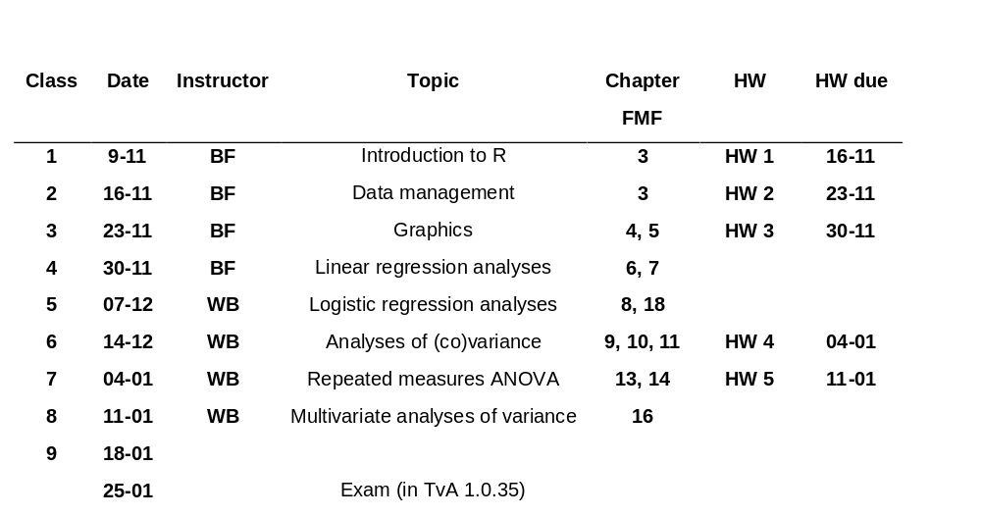
Schedule
Note. FMF = Field, Miles, and Field (2012). BF = Bernd Figner; WB = William Burk

